Slide 1
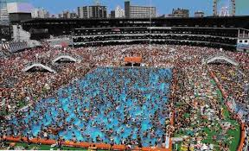
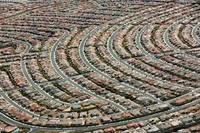
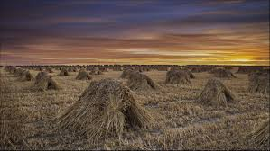
Geog 10001: The Geography of Scarcity
Malthusian Theories of Famine
Dr. Sangeetha Chandrashekeran
schandr@unimelb.edu.au

Slide 2
Today we will cover…
Today’s lecture
Intro
Malthusian explanations of famine
(i.e. the simple version)
Principles of growth, critique, revival
Outcomes and Conclusions

Slide 3
Population problem
Population growth underpins the reasons for famine in our modern world
Strongly agree
Agree
Neutral
Disagree
Strongly disagree

Slide 4
Malthus

Slide 5
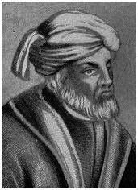
He wasn’t the first…
"What most frequently meets our view (and occasions complaint), is our teeming population: our numbers are burdensome to the world, [The earth] scarcely can provide for our needs; as our demands grow greater, our complaints against nature's inadequacy are heard by all. The scourges of pestilence, famine, wars, and earthquakes have come to be regarded as a blessing to overcrowded nations, since they serve to prune away the luxuriant growth of the human race." Tertullian (c. 155-220)

Slide 6
He wasn’t the first…
"What most frequently meets our view (and occasions complaint), is our teeming population: our numbers are burdensome to the world, [The earth] scarcely can provide for our needs; as our demands grow greater, our complaints against nature's inadequacy are heard by all. The scourges of pestilence, famine, wars, and earthquakes have come to be regarded as a blessing to overcrowded nations, since they serve to prune away the luxuriant growth of the human race." Tertullian (c. 155-220)

Slide 7


… nor the last?

Slide 8
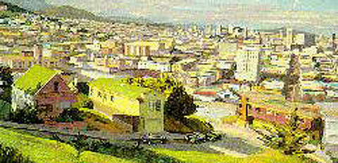

In Australia?
Local limits
Drawing new boundaries?
bioregionalism: largely ‘self-sufficient’ ecologically defined areas
Tim Flannery
Optimum population of 6-12 million

Slide 9
In Australia?
Local limits
Drawing new boundaries?
bioregionalism: largely ‘self-sufficient’ ecologically defined areas
Tim Flannery
Optimum population of 6-12 million
Australian Conservation Foundation
more people = bigger environmental problems
national policy to stabilise population
Sustainable Population Australia
stabilise population; promote small families; zero net migration program
Aid rather than immigration
Australian Greens
Population policy needed
Cannot look at population numbers in isolation

Slide 10
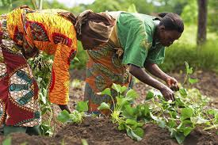
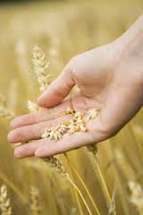
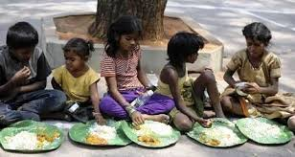
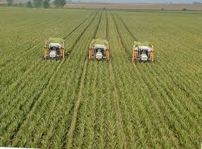
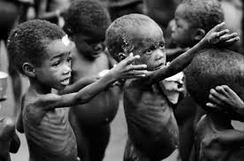
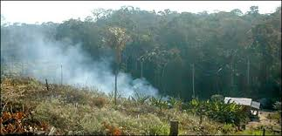
Food supply and population

Slide 11
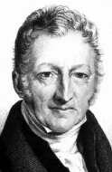
The problem according to Malthus
Thomas Robert Malthus (1766-1834)
A minister of the Church of England
England's first academic economist
Famous for An Essay on the Principle of Population (1798)
‘Demographic pessimism’

Slide 12
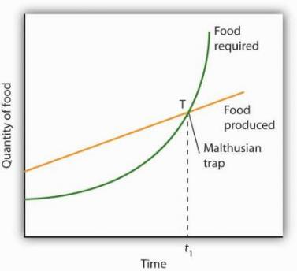
The problem according to Malthus
Malthus: two incompatible trends.
Essay on the principle of population (1798)
Population grows exponentially

Slide 13
World Population
1000 - 1650: 650 years to double
1650 – 1804: 154 years to double
1804 - 1927: 123 years to double
1927 – 1975: 47 years to double
1975 – 2030: 55 years to double

Slide 14
0001AD: quarter of a billion people (about same as USA population in 1990)
16 centuries
1650AD: doubled to half a billion
2 centuries (trade, old/new world)
1830: doubles again to 1 billion
1 century
1930: doubles: 2 billion
1.2 centuries
More than quadruples?
2050: 9 billion?

Slide 15
The problem according to Malthus
Malthus: two incompatible trends.
Resources grow linearly
Eventually population outpaces resources
‘Natural’ limits: famine, starvation, death

Slide 16

Why did he believe this?

Slide 17
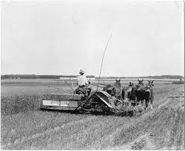
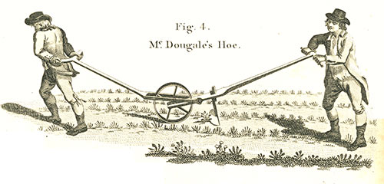
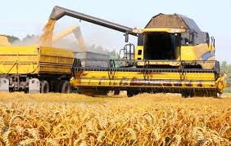
Why did he believe this?

Slide 18

The problem according to Malthus
Malthus: two incompatible trends.
Poor most vulnerable
But supporting poor = more population growth
Therefore: Moral restraint
“ Toward the extinction of passion between the sexes, no observable progress whatever has been made…”
- Malthus, T. R. 2008, p 216

Slide 19
The problem according to Malthus
Agricultural output
Famines
Food production
(abundant)
Food
not abundant
Population
Time

Slide 20
“gigantic inevitable famine stalks … and with one mighty blow levels the population with the food of the world”
- Malthus T.R. 1798. An essay on the principle of population. Chapter VII, p61

Slide 21
The problem according to Malthus
Preventative checks
Food production
Agricultural output
Reduce birthrate
‘preventative check’
Population
Time

Slide 22
The problem according to Malthus
Positive checks
Famines: a ‘positive check’
Agricultural output
Food production
Population
Time

Slide 23
The problem according to Malthus
Malthus in a nutshell:
Natural limitations to population growth
Abundance encourages growth
Unless prevented by checks
Preventative checks ( ↓ birth rates), or positive checks ( ↑ death rates)
So, for Malthus, the answer is:
increase means of subsistence to match population growth
But this can’t go on forever, so…
Preventative checks to reduce population growth
OR ELSE!

Slide 24
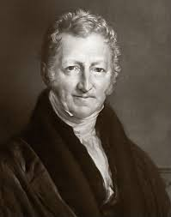
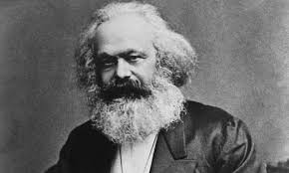
Marxist critique

Slide 25
Marxist critique

Slide 26
Neo-Malthusians (Part 1)

Slide 27
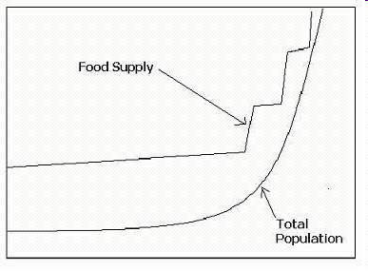

Slide 28


1700s TO 1970s:
Neo-Malthusians?
Root of problem is exponential growth
Population growth enormous and hard to slow (extra 3.2 billion, possibly more, by 2050)
Food production cannot keep up (limits to growth)
So, food shortages likely to be more frequent and more intense
= Famine is driven by these factors and is more likely to occur

Slide 29
Limits to Food Production
Fisheries depleted
60% of fisheries ‘heavily exploited’
34% of world’s coastal regions ‘at risk’
Land availability & degradation
2025: up to 1 billion living in areas where cultivated land is critically scarce
1 billion at risk from dryland degradation
Water resources
2025 more than 2.8 billion facing water stress
Climate Change
Reduced agricultural production and (increased volatility)
Resources in general…

Slide 30
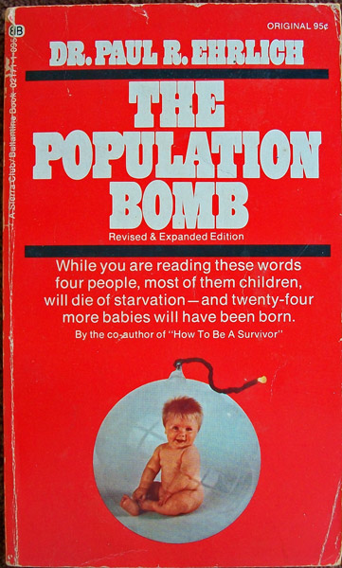
Why do people still believe it?
Supported by well known and respected environmental experts…
Worldwatch Institute
State of the World reports
Lester Brown
Paul Ehrlich – The Population Bomb
Norman Myers
Club of Rome
The Limits to Growth
FOOD TECHNOLOGIES cannot keep up with population growth (?)

Slide 31
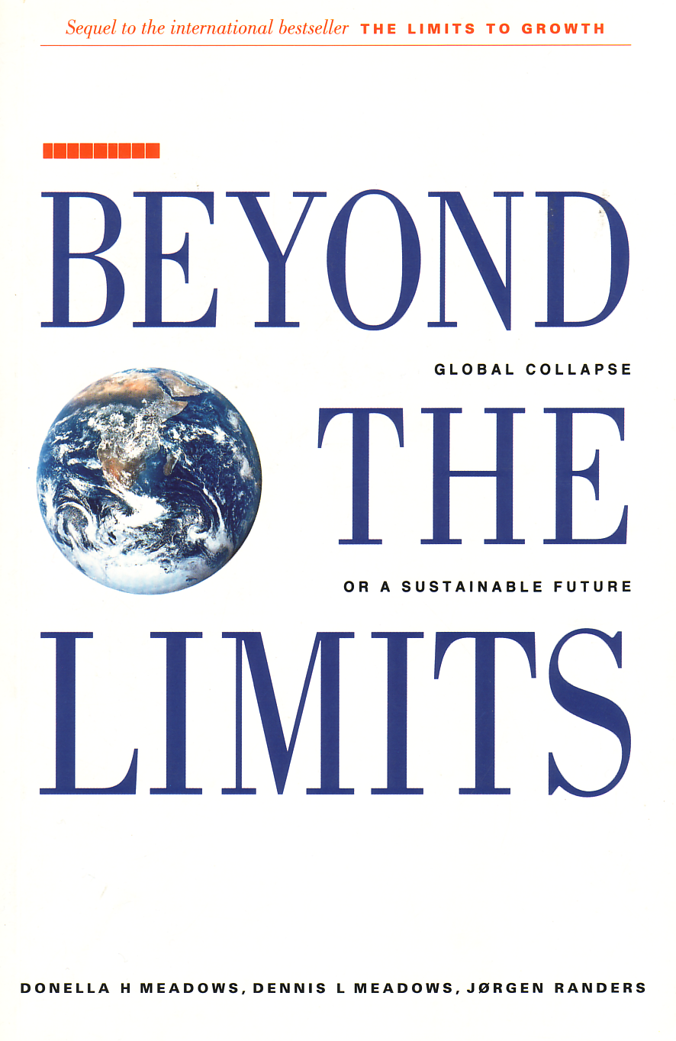
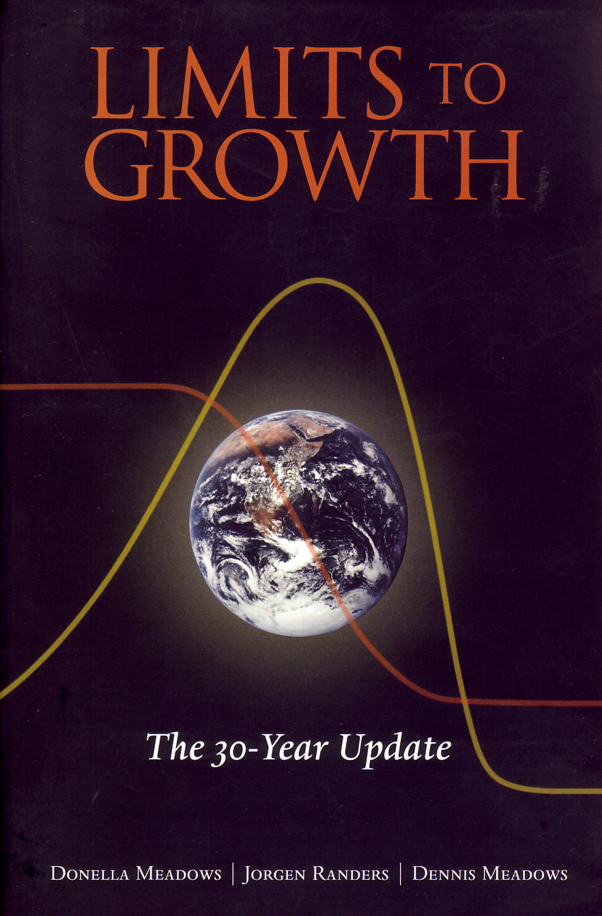
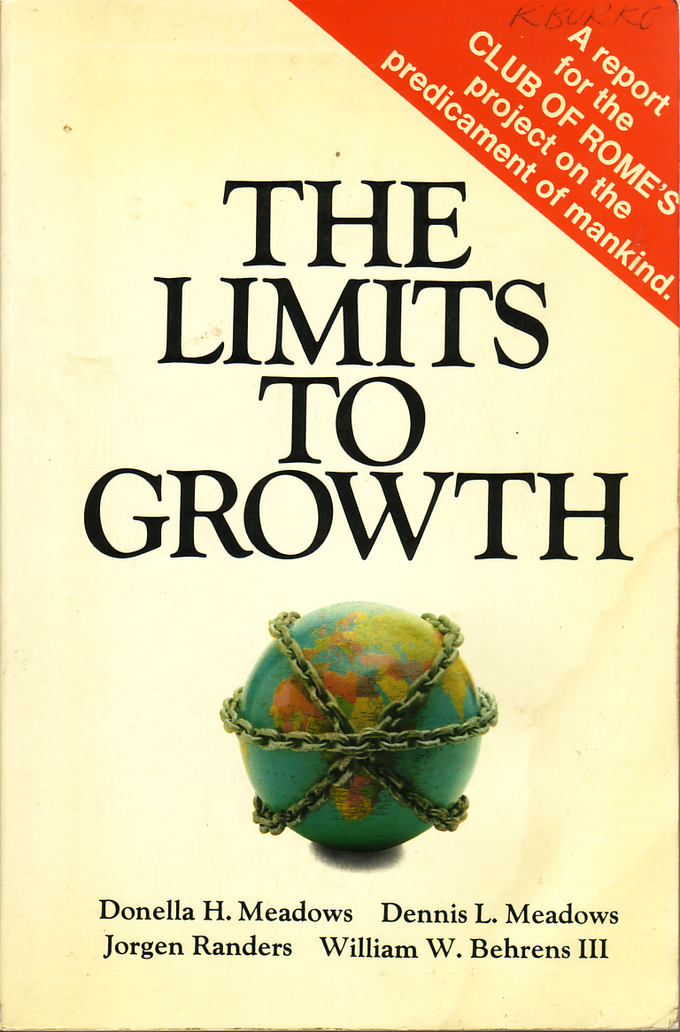

Slide 32
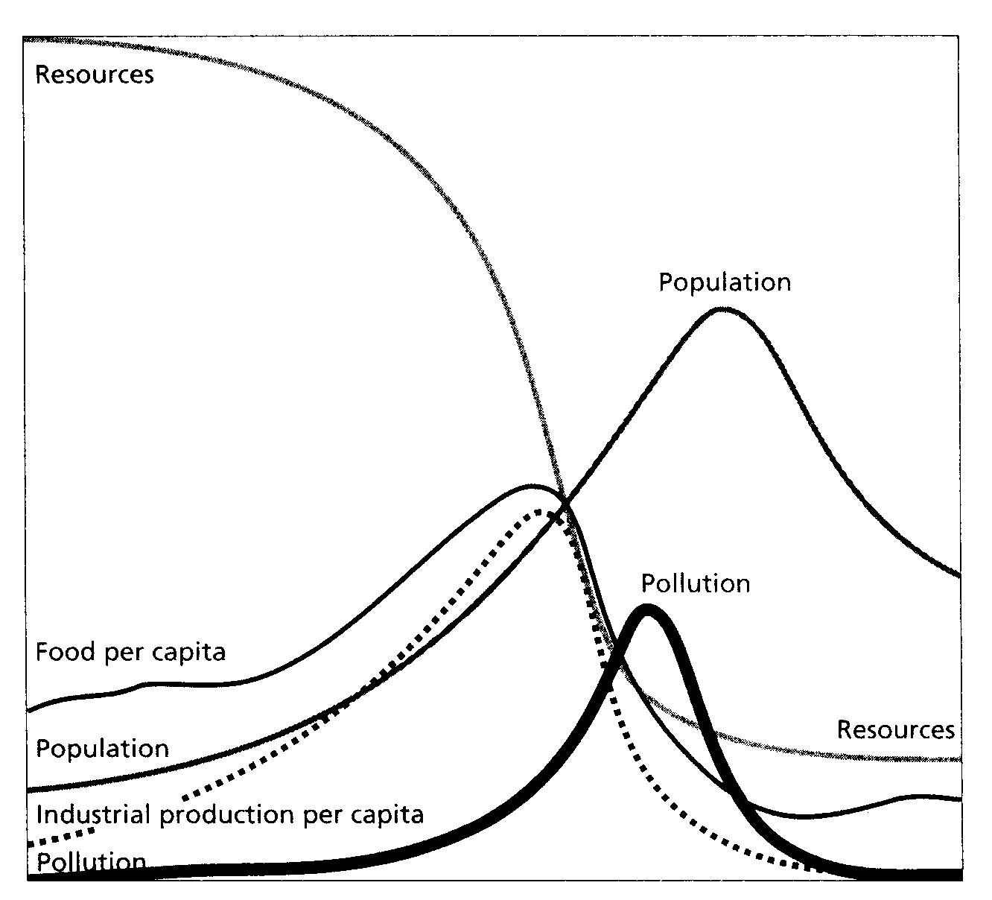
Limits to growth?

Slide 33
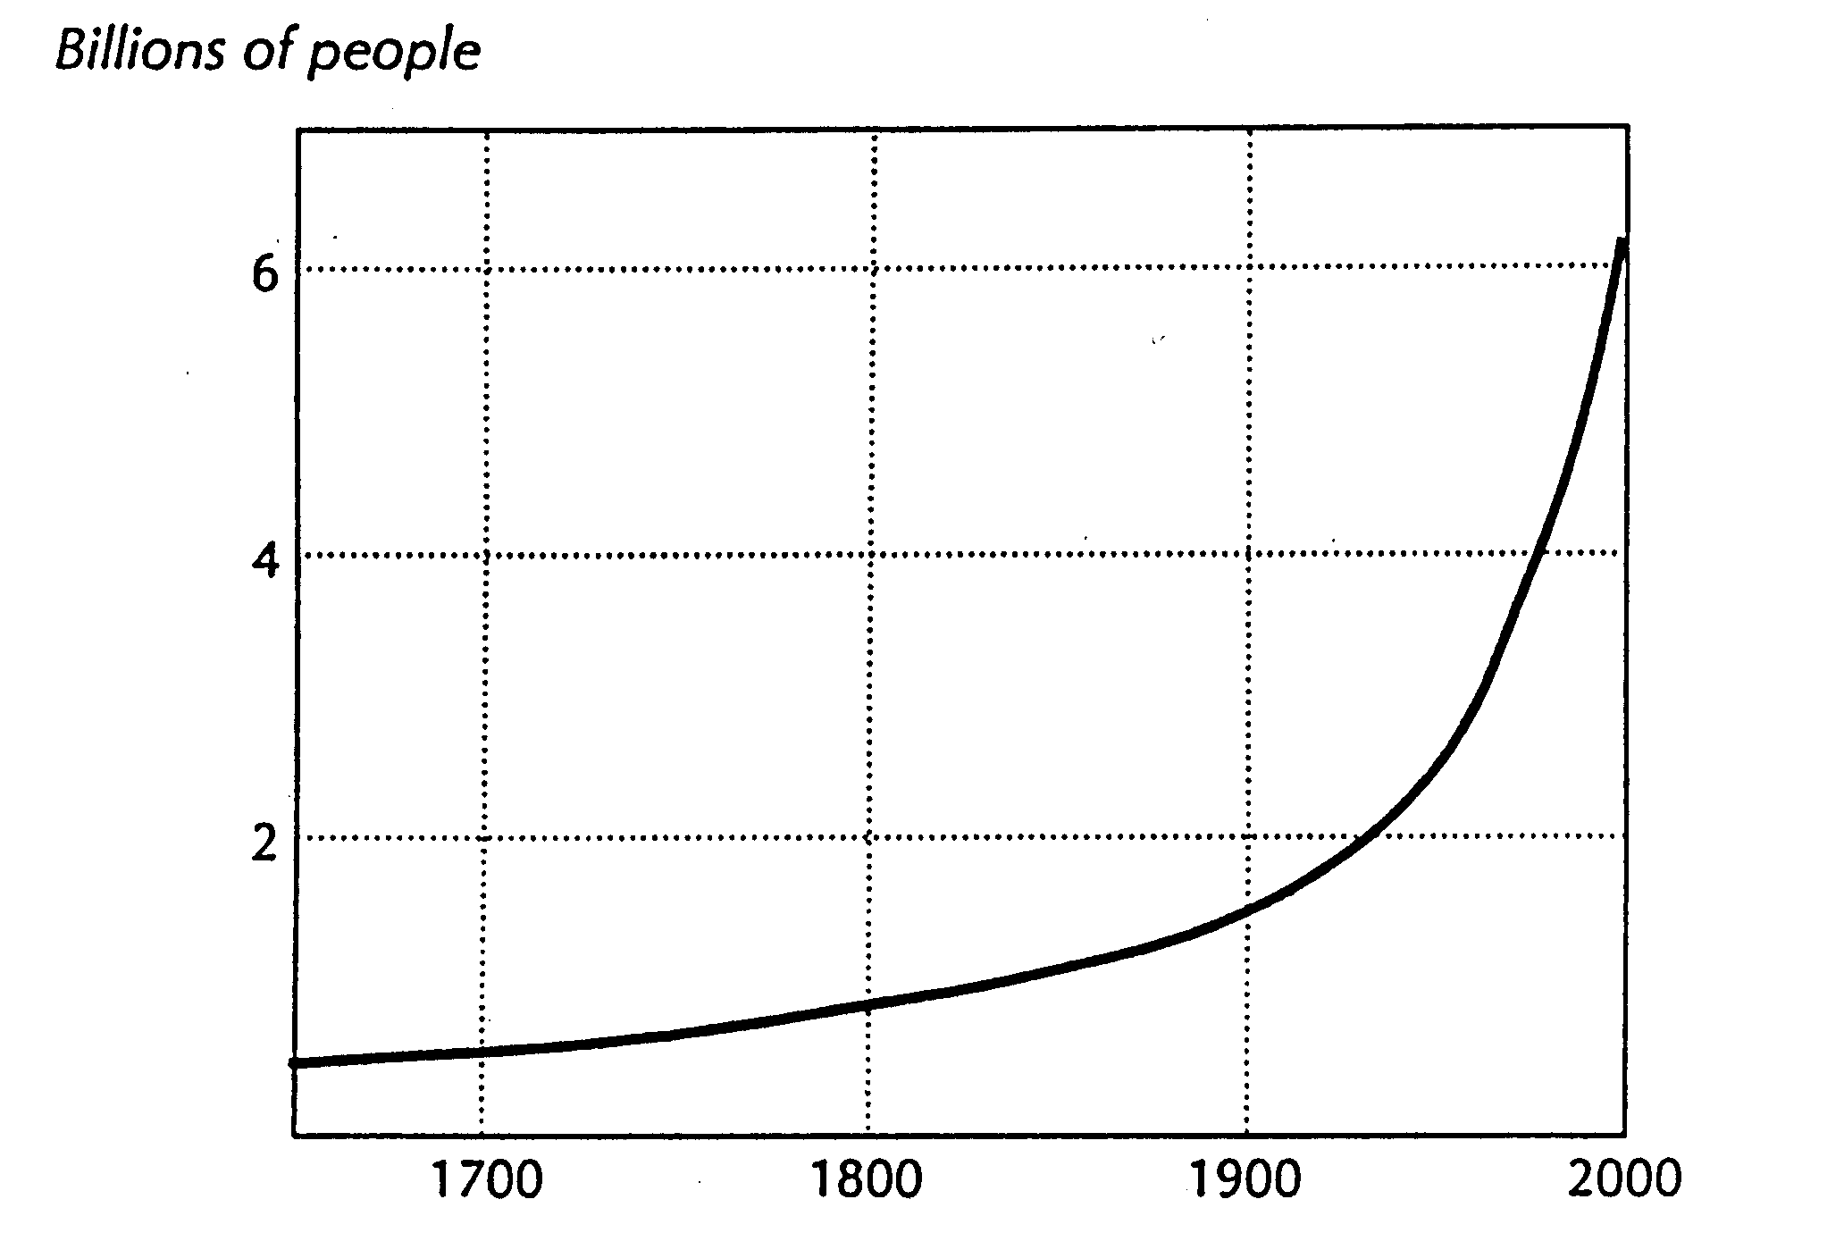
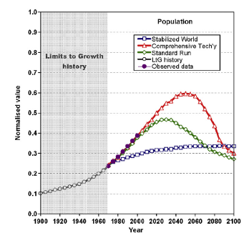
World Population

Slide 34
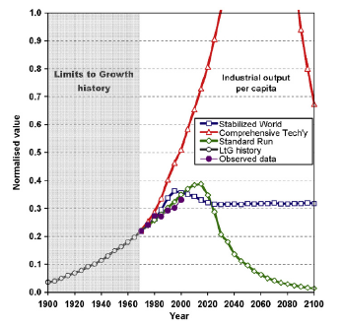
Global industrial production

Slide 35
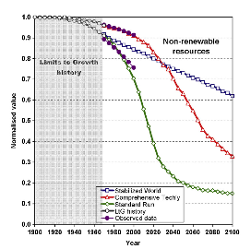
Global non-renewable resources

Slide 36
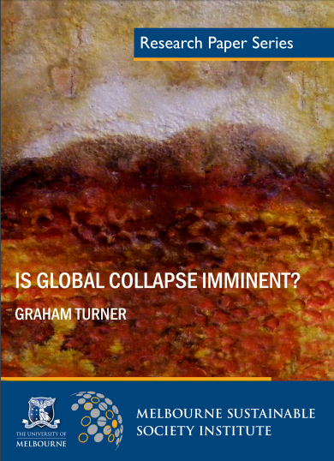

Slide 37
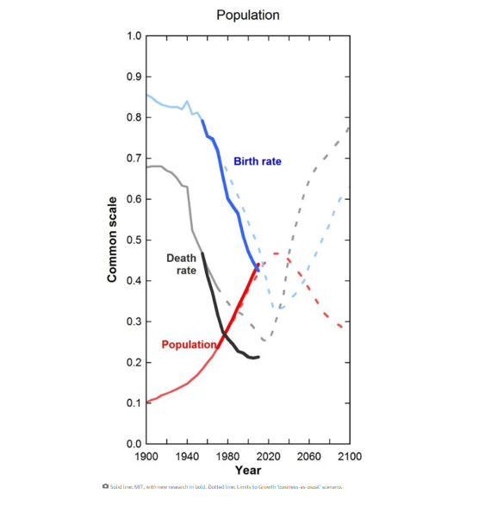

Slide 38
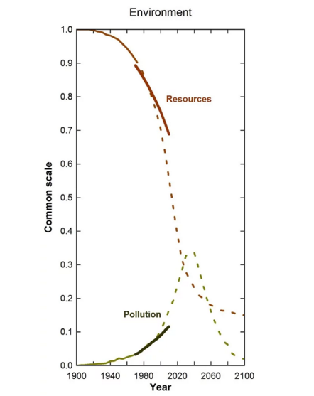

Slide 39
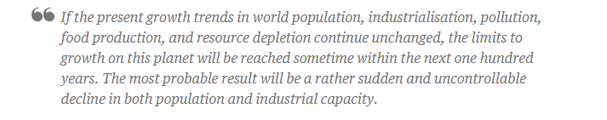

Slide 40
Neo-Malthusians
Neo-Malthusianism and Malthus
Both are concerned with the abundance of food relative to population
together = the relative abundance argument

Slide 41
Neo-Malthusians
But Neo-Malthusians also consider:
Environmental degradation
Development (a post WWII concept)

Slide 42
Neo-Malthusians
But Neo-Malthusians also consider:
Environmental degradation
Development (a post WWII concept)
Diminishing returns from agriculture
Non-renewable resources

Slide 43
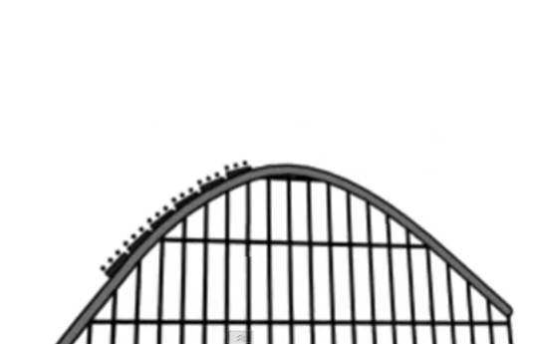
Overpopulation is a myth?

Slide 44
Malthus: Outcomes and conclusions

Slide 45
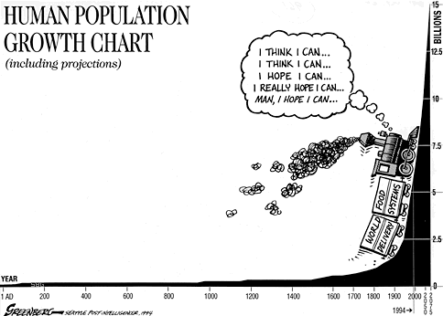

Slide 46
Conclusions
Malthus
Population grows geometrically; agricultural production arithmetically
point of crisis, food keeps population in check
Solution? Moral choices, abstinence
Relative abundance argument (Malthusian)
?

Slide 47

Conclusions
Malthus
Population grows geometrically; agricultural production arithmetically
point of crisis, food keeps population in check
Solution? Moral choices, abstinence
Relative abundance argument (Malthusian)
Neo-Malthusians:
Revival in the 1960s and 1970s
Malthus with an eco-slant
Population + consumption = destruction
Neo-malthusians had a revival in the 1970s as a result of increased understanding on global ecological crises (what about 2000s?)
?

Slide 48
Next time: neo-Malthusians and technological change

